Slide 1
CloudCore – Modern Workplace Apps
Ben Stegink

Slide 2

Day Four Rundown
Timeframe | Activity | Engagement
7:30 – 8:00 | Welcome / Check in
8:00 – 9:00 | Expanding the modern workplace | Interactive Discussion
9:00 – 9:15 | Break
9:15 – 11:00 | WBD: Design an M365 PP Collaborative Environment | Hands On: Group Work
11:00 – 12:00 | Lunch
12:00 – 2:00 | Team Challenge Deliver an M365 + PP Collaborative Environment | Hands On: Group Work
2:00 | Wrap Up the Day

Slide 3

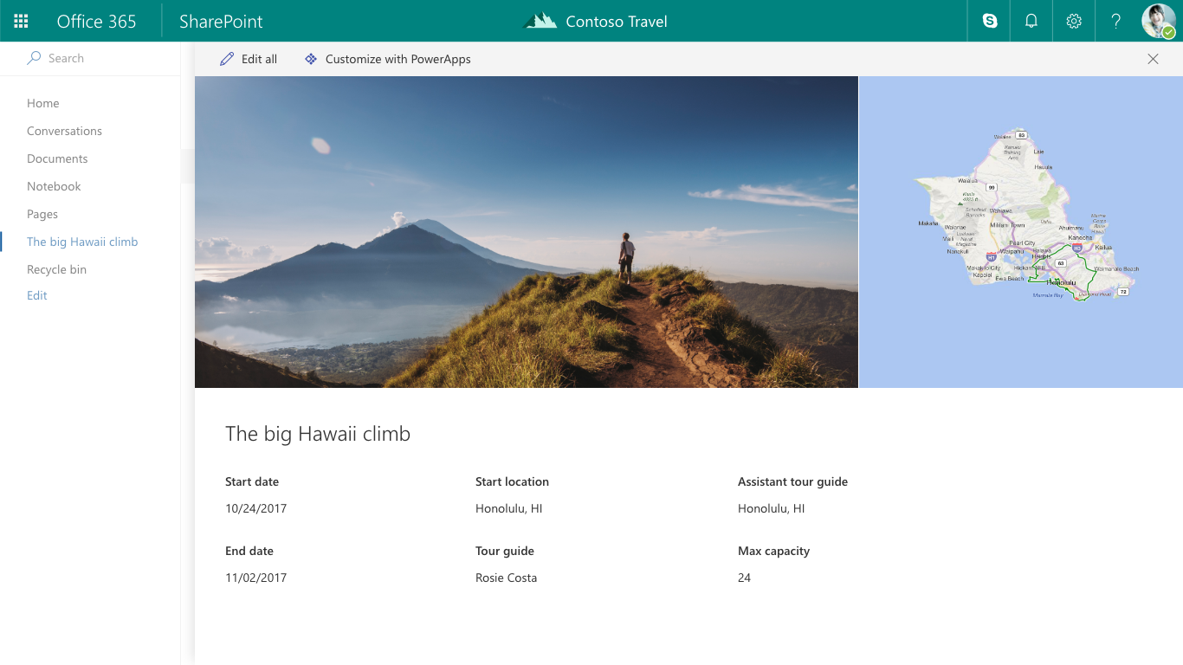

Transform business process
Automate processes and connect data with Power Automate
Create custom forms and mobile apps with Power Apps
Transform business processes

Slide 4
Power Automate & Power Apps
Build modern business apps – fast
Empower line of business
Measure
Automate
Act
Enable developers to extend
Power users
Power BI
Flow
PowerApps
Connect to data across apps and platforms
Developers
Data Lake analytics
Analysis Services
…
Logic Apps
API Management
…
App Service
Functions
…
SharePoint
Connectors + gateways
Common Data Service

Slide 5
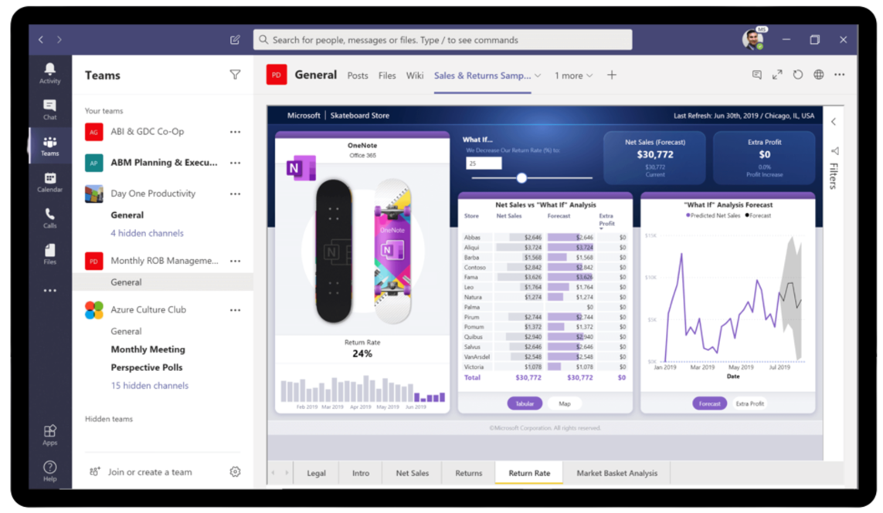
Power BI
Embed
Teams
SharePoint
Apps
Azure AD
Intune
Defender
Microsoft 365 Usage

Slide 6
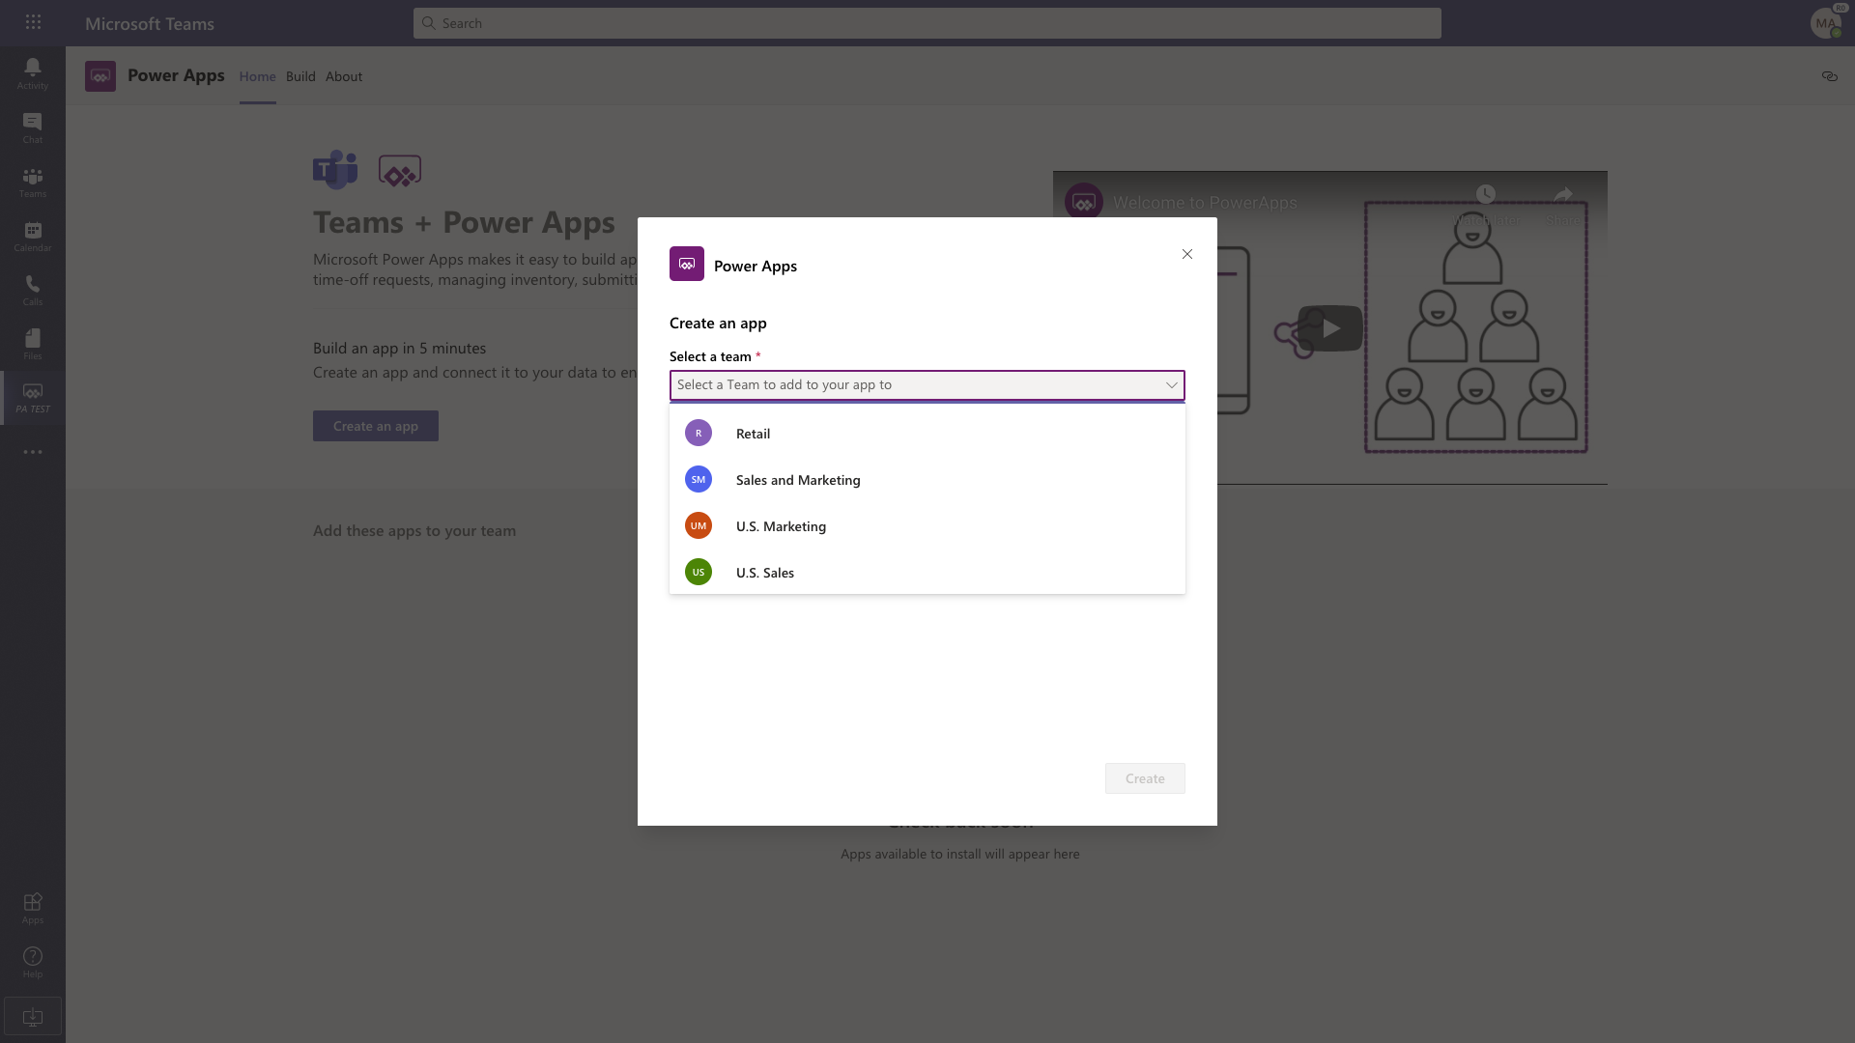
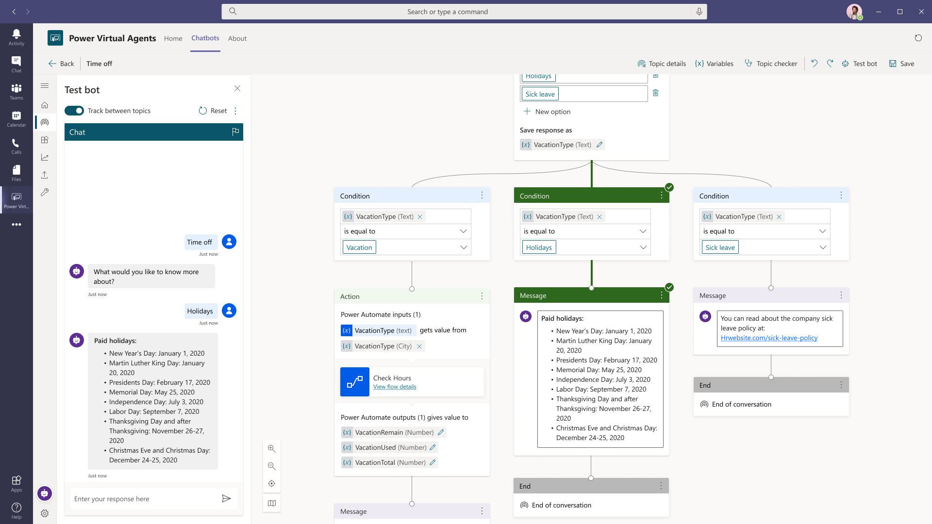
Project Oakdale
Teams only
CDS Database
1 Database/Team
New Power Platform environment/Team
Notes:
Project Oakdale delivers a built-in, low-code data platform for Microsoft Teams. It provides relational data storage, rich data types, enterprise-grade governance, and one-click solution deployment. Project Oakdale enables everyone to easily build and deploy apps.
Support to build low-code and no-code apps, flows, and chatbots for and within Teams.
Core data capabilities from the same platform behind Microsoft Power Platform and Dynamics 365.
Storage, rich data types with enterprise capabilities, and one-click solution deployment.
A new visual editor that makes it even easier to define and populate table data.
Enterprise security that's easy to use and aligned with the approach used in Teams.
Inclusion in most existing Teams licenses.
Storage of 2 GB per team, and support for up to 1 million rows.
Support for up to 500 teams.
The capability to be promoted to Common Data Service.
Security
These tables and the applications that use them are secured with enterprise-grade security that's easy to understand and use for low-code and no-code developers. Security in Project Oakdale aligns to how security is handled in Teams, with a focus on Owners, Members, and Guests.
Project Oakdale vs. CDS - https://docs.microsoft.com/en-us/powerapps/teams/data-platform-compare

Slide 7
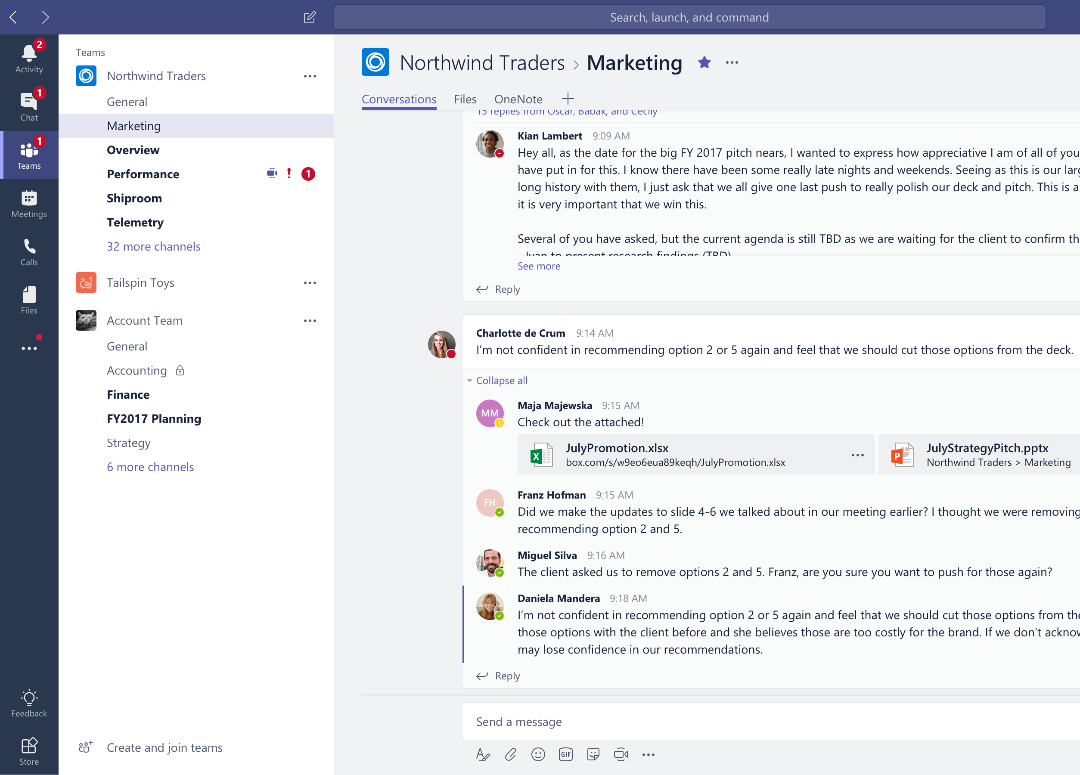
Collaborate with integrated Office 365 apps
Quick access to the apps you love and are familiar with

Slide 8
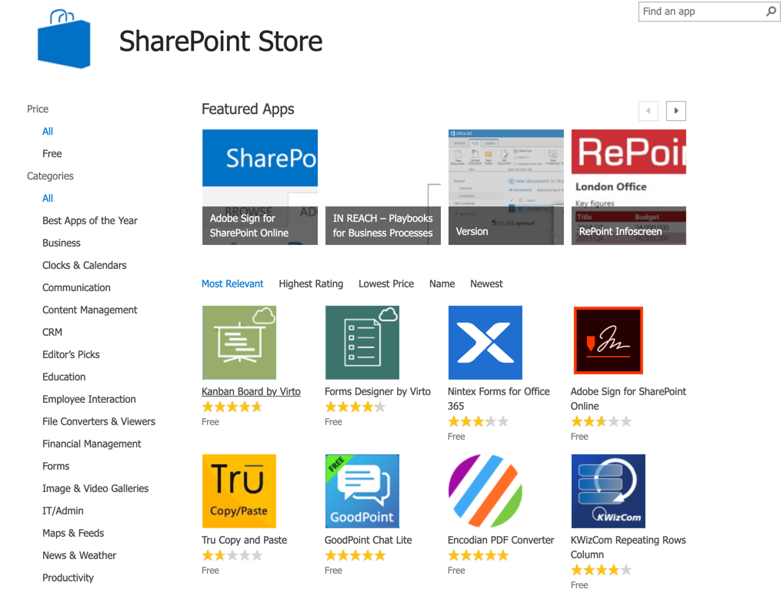
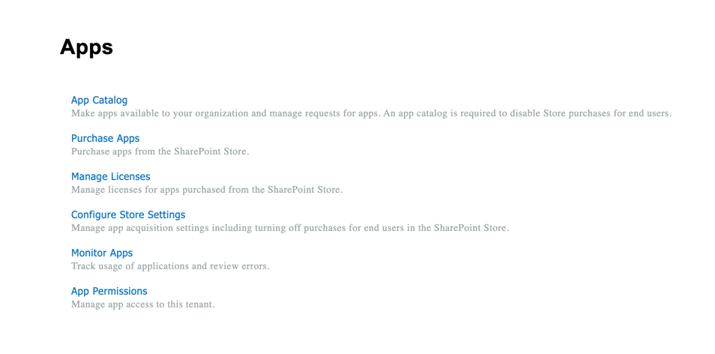
SharePoint Apps
SharePoint Store
App Catalog

Slide 9
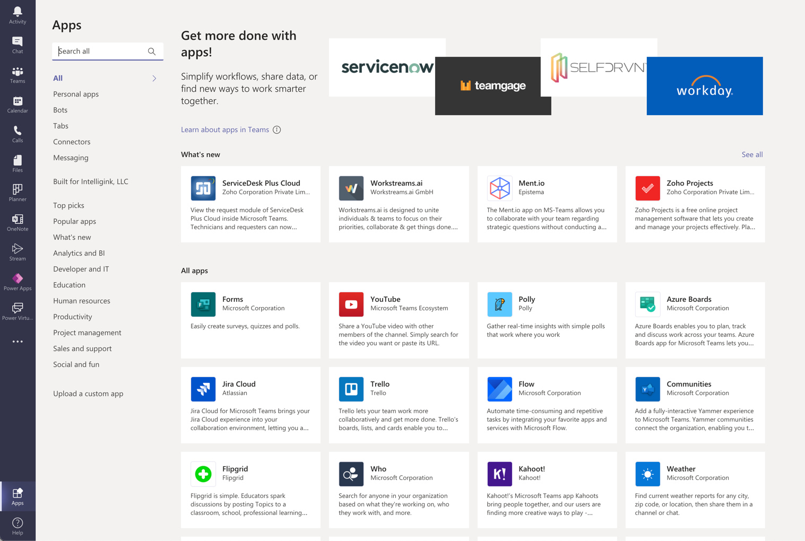
Teams Apps
First party/Microsoft
App Store
Power Apps
Custom

Slide 10
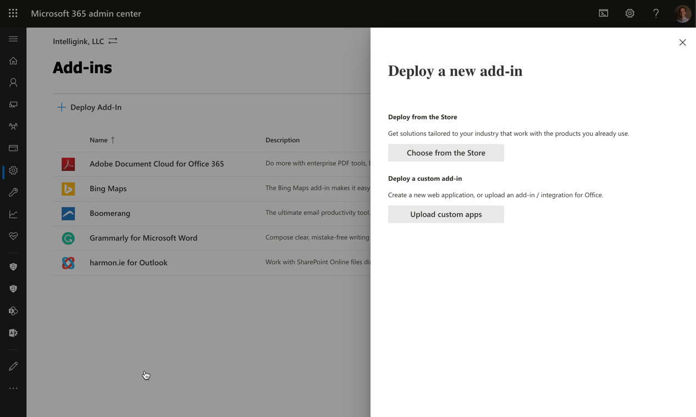
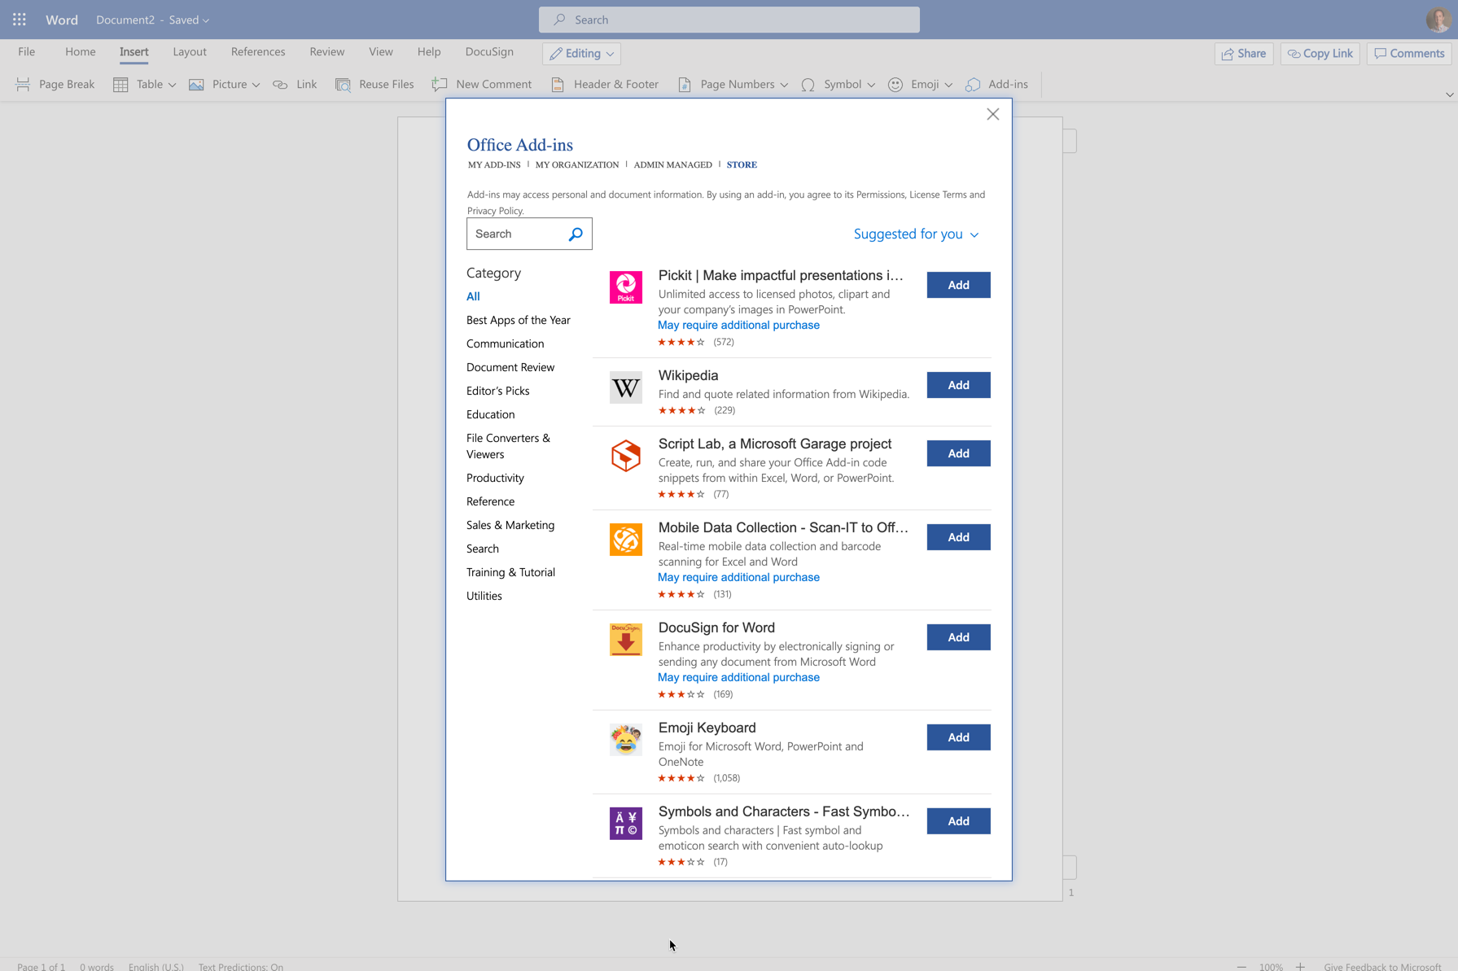
Office Apps
User installed
Centrally managed & Custom

Slide 11





Why Build a Custom Teams App?
Leverage the Hub experience
Tailor your teamwork
Industry
Contextual interactions
Departmental processes
Target the audience for your app
Employee services
Conversations come free!
Productivity tools
Securely connect with your data
Build once, use everywhere
Approvals & workflows

Slide 12
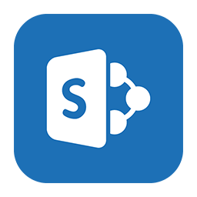
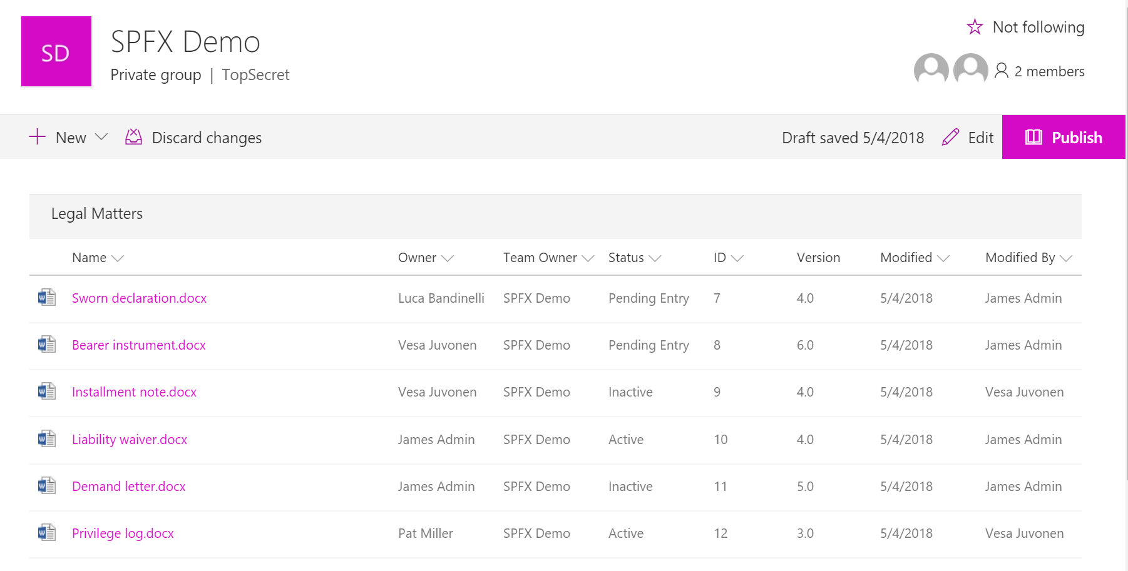
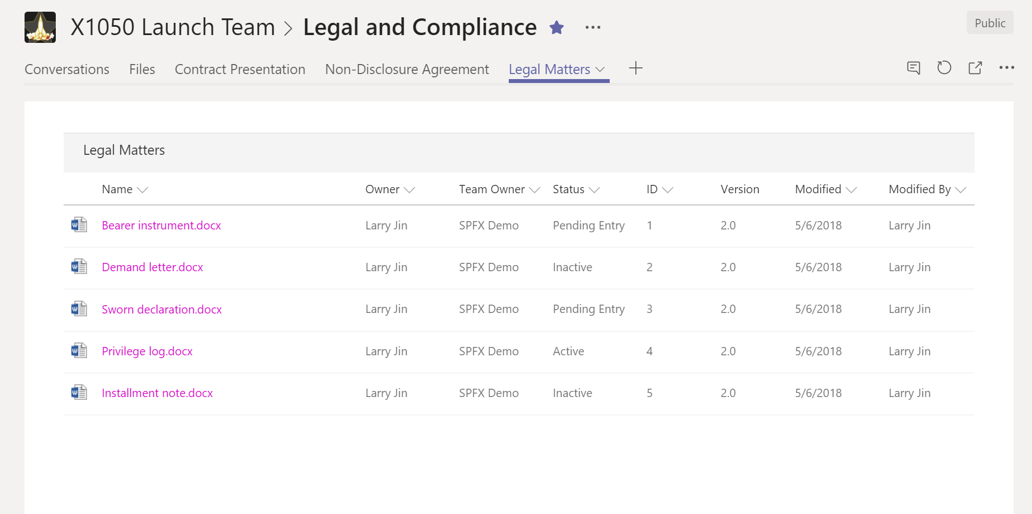
Bring SharePoint apps and content into Teams
Expand the reach of your existing SharePoint solution
Reuse all your existing code
Deploy as an LOB app in Teams

Slide 13
What is SPFx?
An application framework used to build and extend modern experiences in SharePoint.
Microsoft Graph
SPFx Extension header
Web parts
Page visuals Office UI Fabric
SPFx Extension footer

Slide 14
Create tabs in Teams with the SharePoint Framework

Slide 15
Extending Microsoft 365 with Graph

Slide 16
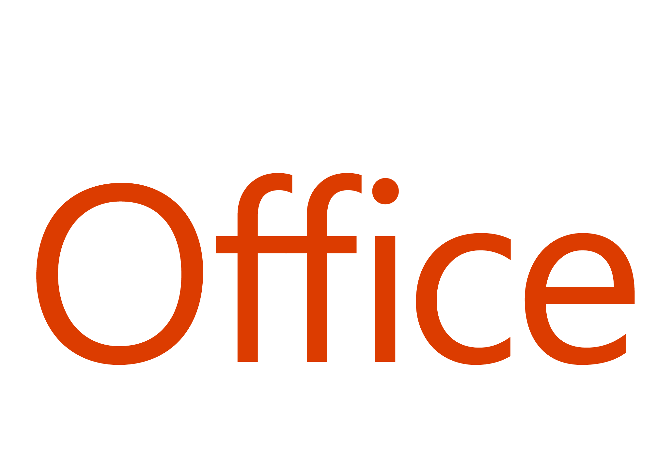
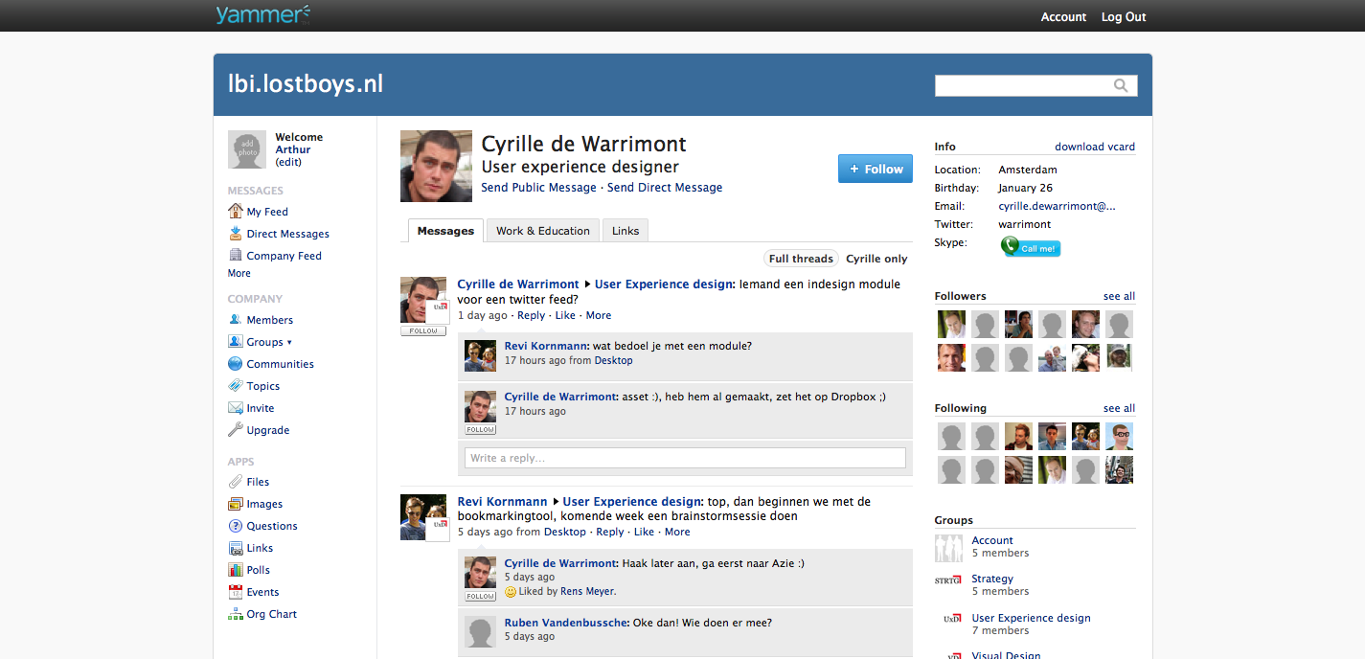
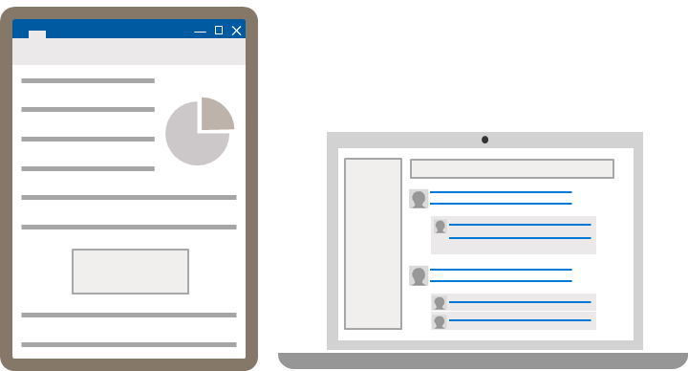
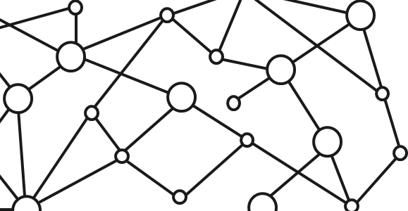
Ultimate Hub for Teamwork starts with Office 365 Platform
EXTENSIONS
STANDALONE WEB, DEVICE, AND SERVICE APPS
DOCUMENTS
PAGES


CONVERSATIONS
EMBEDDED CANVASES
CANVASES
1
Microsoft Graph

Slide 17
Collaborate with integrated Office 365 apps
Quick access to the apps you love and are familiar with

Slide 18

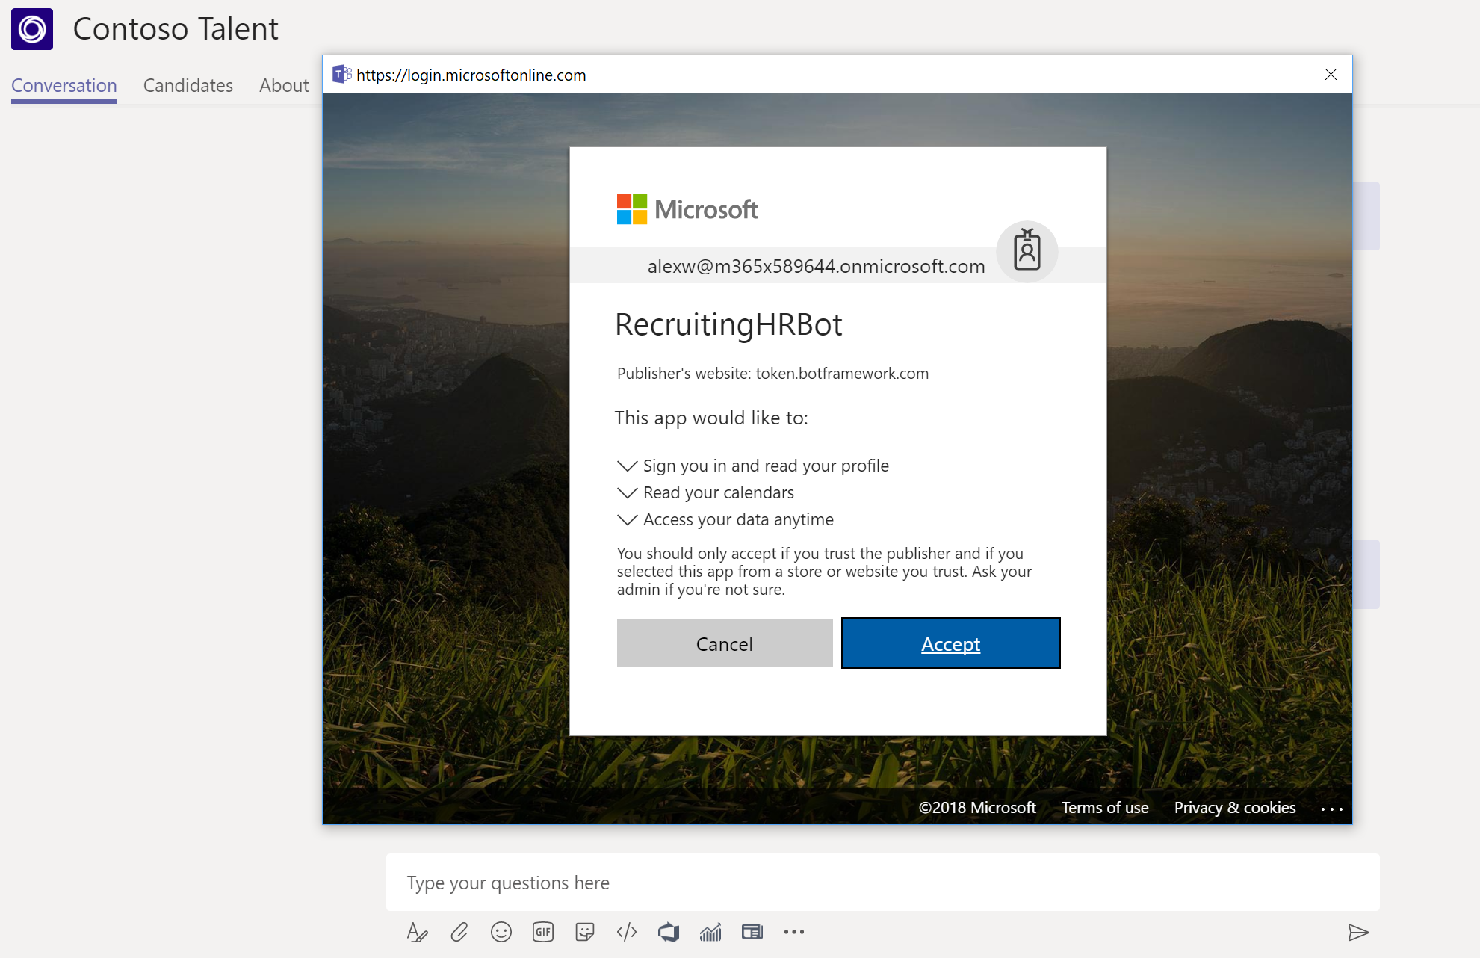
Add insights from the Microsoft Graph
Integrate intelligence and insights directly from the Graph in your Teams app
Sign users in through inline login experience
Simplify credential management via new Azure Bot Services OAuthCard

Slide 19
Microsoft Graph Gateway to your data in the Microsoft-cloud
https://graph.microsoft.com
Office 365
Windows 10
Enterprise Mobility + Security
Users, Groups, Organizations
Outlook
SharePoint
OneDrive
Teams
Planner
Excel
OneNote
Activities
Device Relay
Commands
Notifications
Azure AD
Intune
Identity Manager
Advanced Threat Analytics
Advanced Threat Protection
Mail, Calendar,
Contacts and Tasks
Sites and Lists
Drives and Files
Channels, Messages
Tasks and Plans
Spreadsheets
Notes, and more…
Identity Management
Access Control
Synchronization
Domains
Administrative Units
Applications and Devices
Advanced Threat Analytics
Advanced Threat Protection
Alerts
Policies
and more…

Slide 20
Thank you!! https://aka.ms/CloudCoresurvey

